Slide 1
final Testing Plan Results
Powder Coating Oven Team
Verina Abdelmesih
Hussain Alismail
Desiree Dee

Slide 2
Design Requirements
Engineering Requirements:
  ER 1: Rack Holding Weight < 200 pounds
  ER 2: Volume (4 x 4 x 8ft)
  ER 3: Material Cost < $1,500
  ER 4: Heat Loss < 6 W/m^2
  ER 5: Heat Output of 400° Fahrenheit
Customer Requirements:
  CR 1: Weather Resistant
  CR 2: Even Heat Distribution
  CR 3: Material Cost < $1,500
  CR 4: Volume (4 x 4 x 8ft)
  CR 5: Retractable Rack System
  CR 6: Propane Fueled Heater
  CR 7: Control System for Heater
Verina

Slide 3
Top level testing summary
Test | Design Requirement
Test 1: Budget | ER3, CR3
Test 2: Heat Transfer of Composite Wall | ER2, ER4, CR1, CR4
Test 3: Control System Test | ER5, CR2, CR6, CR7
Test 4: Heat Ventilation and Circulation | ER5, CR2, CR6, CR7
Test 5: Curing Technique on Rack | CR2, CR5
Test 6: Rack System Weight Test | ER1, CR5
Verina

Slide 4
Test 1 : Budget
See BOM
Design requirements
  ER3:Material cost < $1,500
  CR3: Material cost < $1,500
Verina

Slide 5

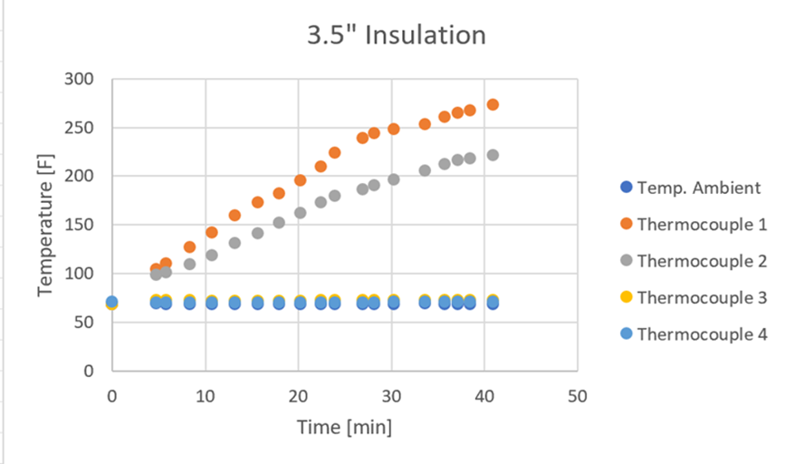
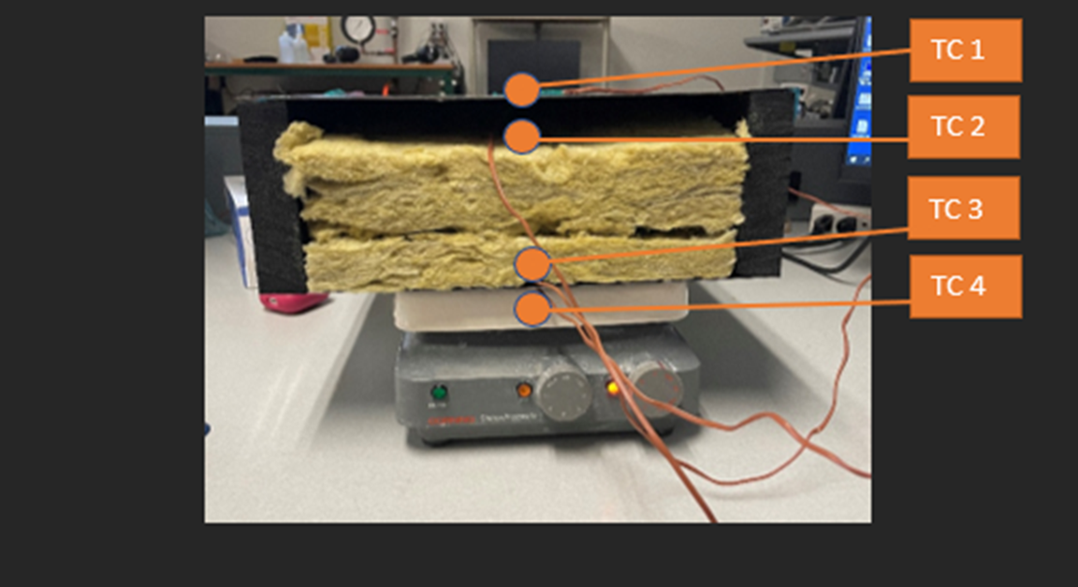
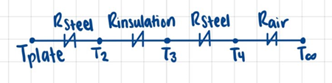
Test 2: Heat Transfer of Composite Wall
Design requirements
  ER2: Volume (4 x 4 x 8 ft)
  ER4: Heat loss < 6 W/m^2
  CR1: Weather Resistant
  CR4: Volume (4 x 4 x 8 ft)
Desiree

Slide 6
Test 3: Control System
Design requirements
  ER5: Heat output of 400 degrees
  CR2: Even Heat Distribution
  CR6: Propane Fueled Heater
  CR7: Control System for Heater
Desiree

Slide 7
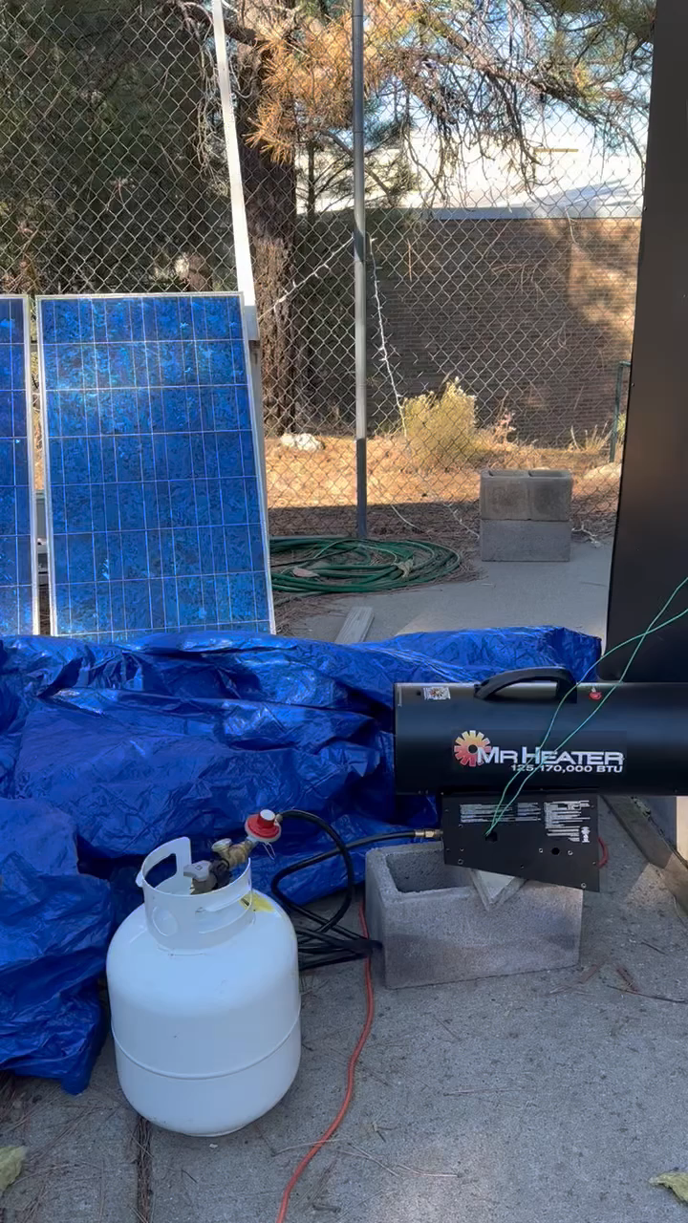
Desiree

Slide 8
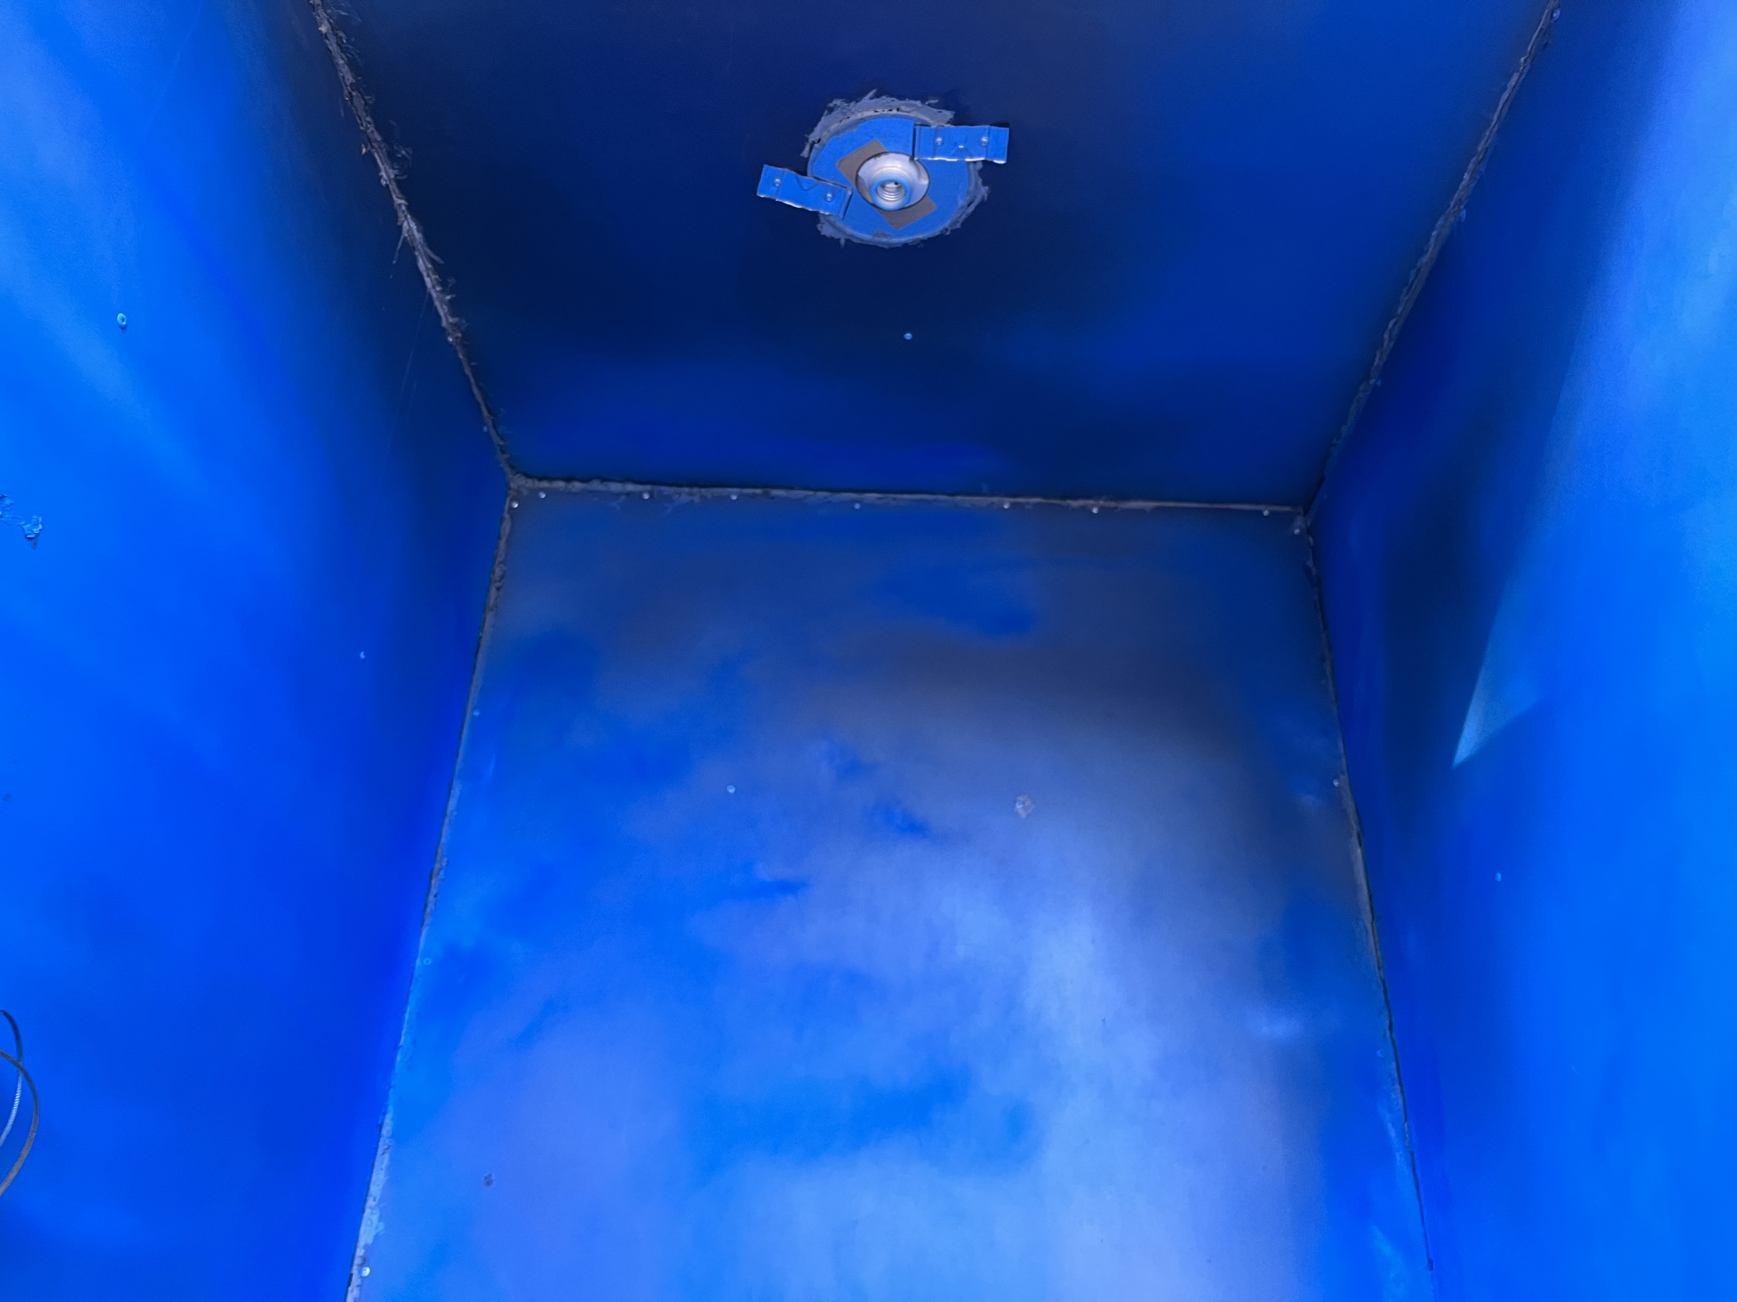
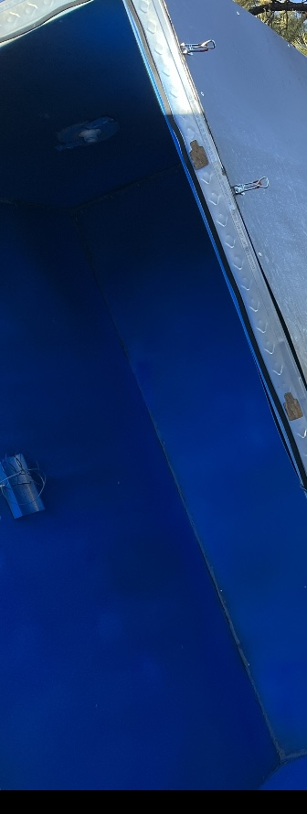
Test 4: heat ventilation and Circulation
Design requirements:
  ER5: Heat output of 400 degrees F
  CR2: Even Heat Distribution
  CR6: Propane Fueled Heater
  CR7: Control System for Heater
One Coat
Two Coats
Hussain

Slide 9
Play Video
Hussain

Slide 10
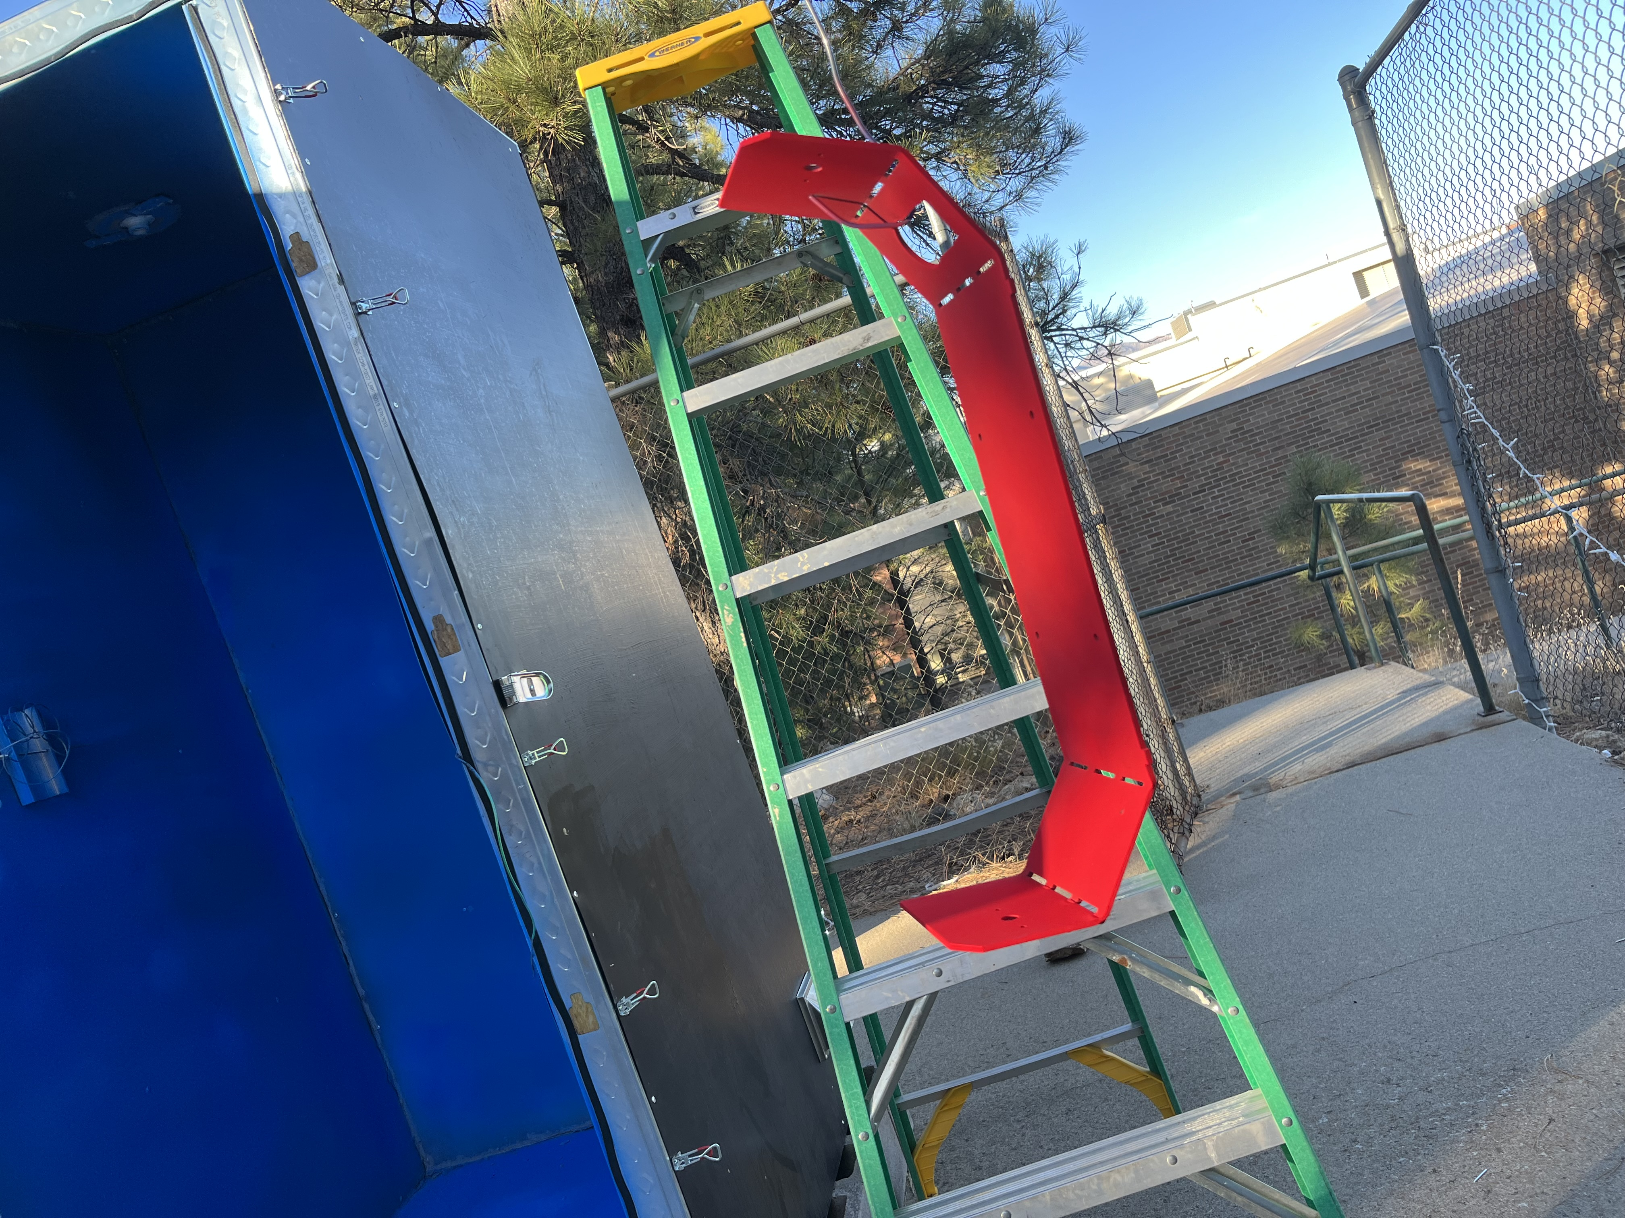
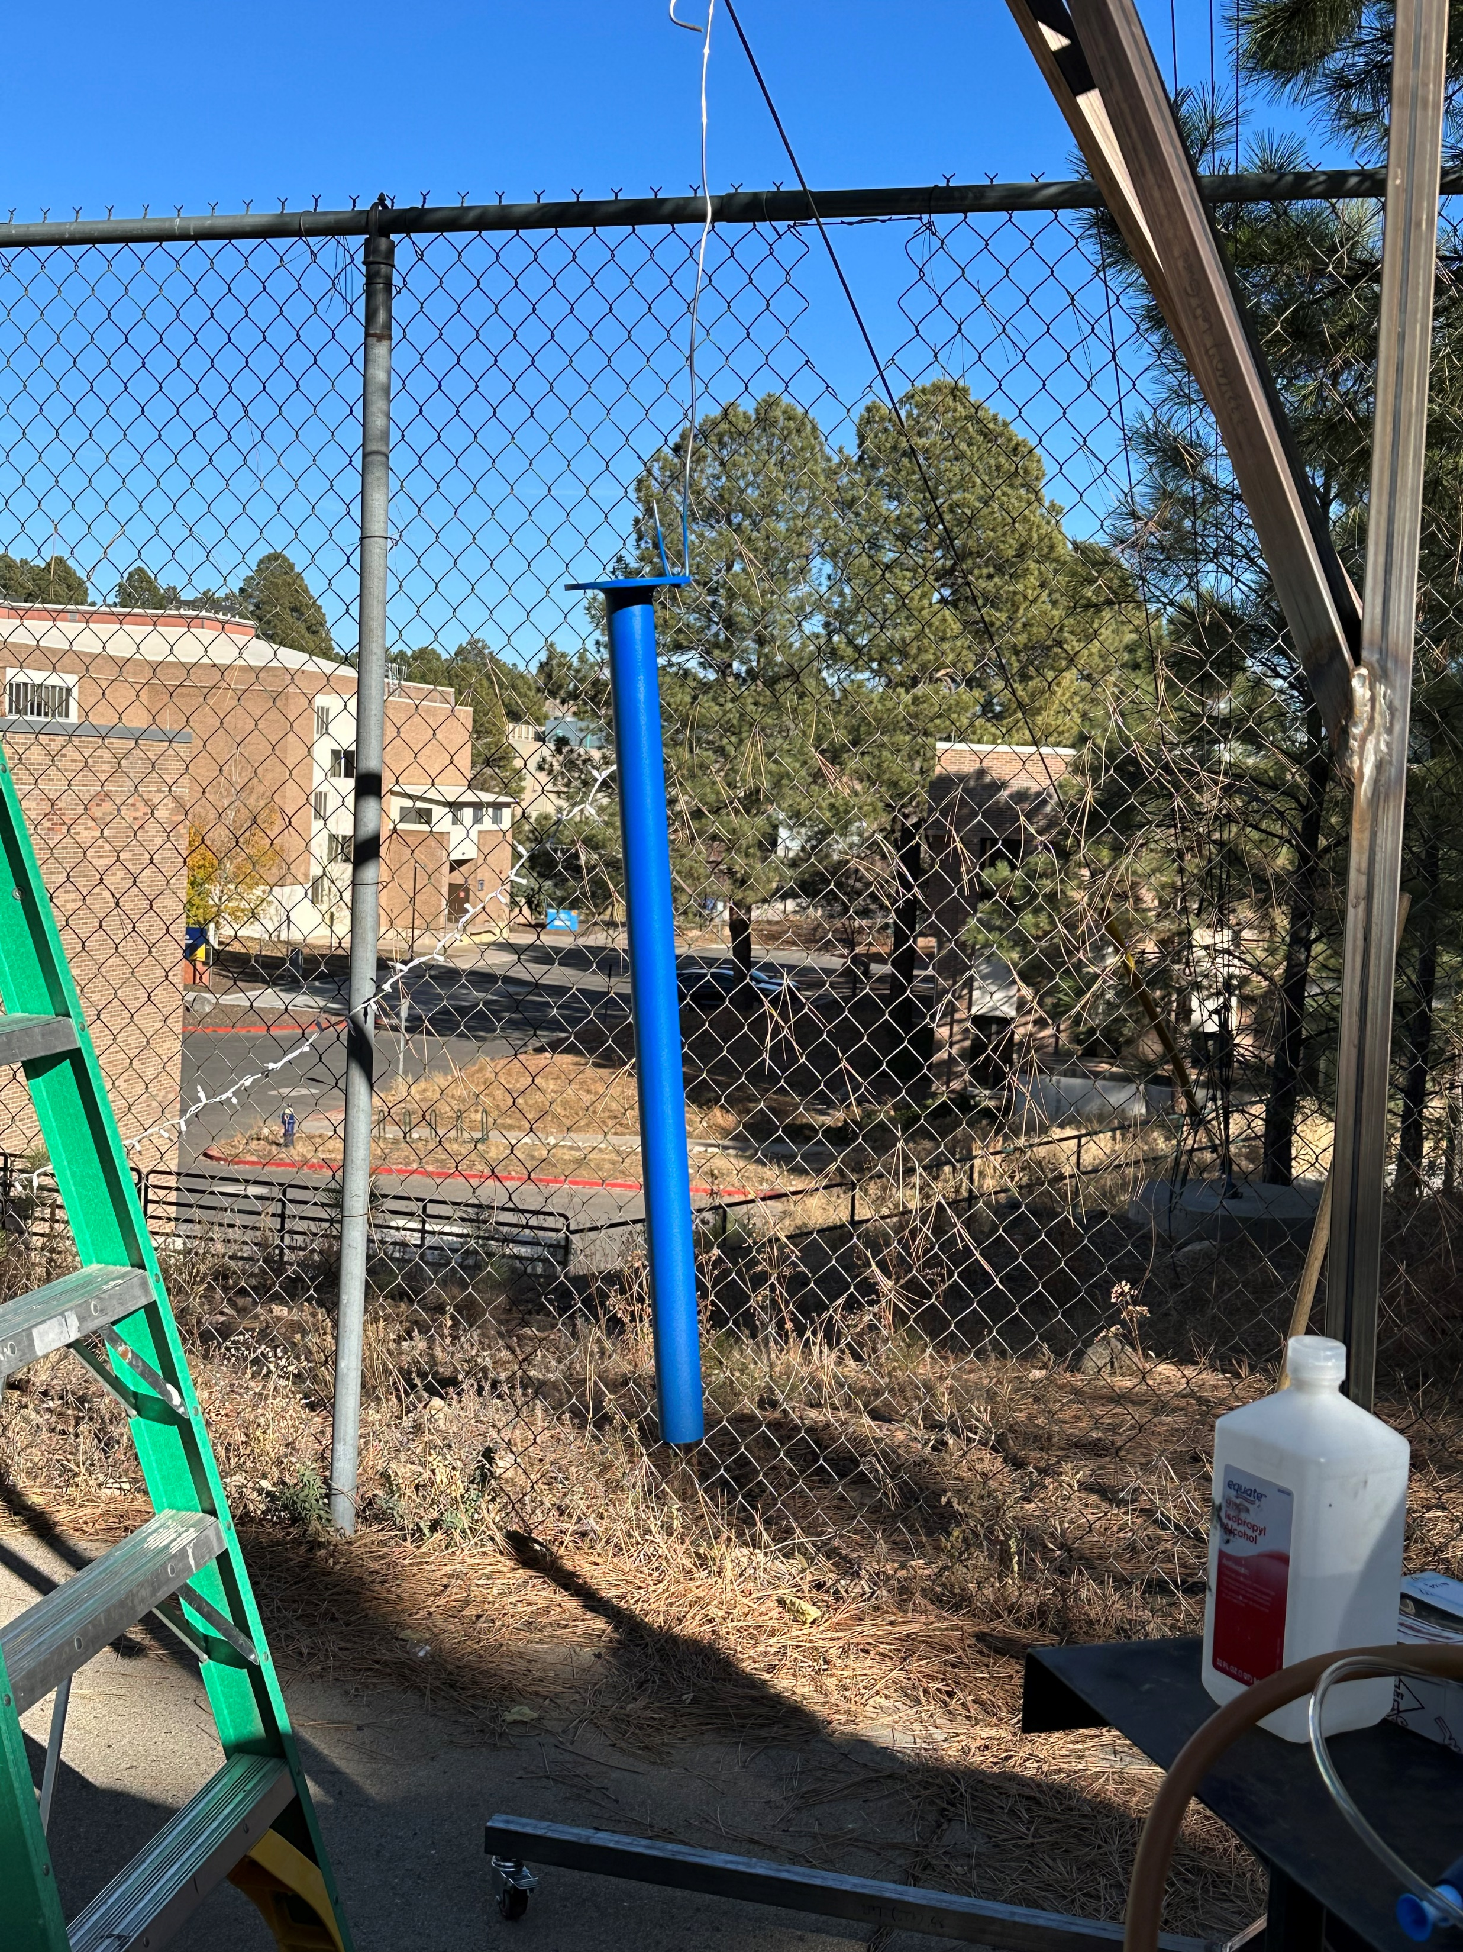
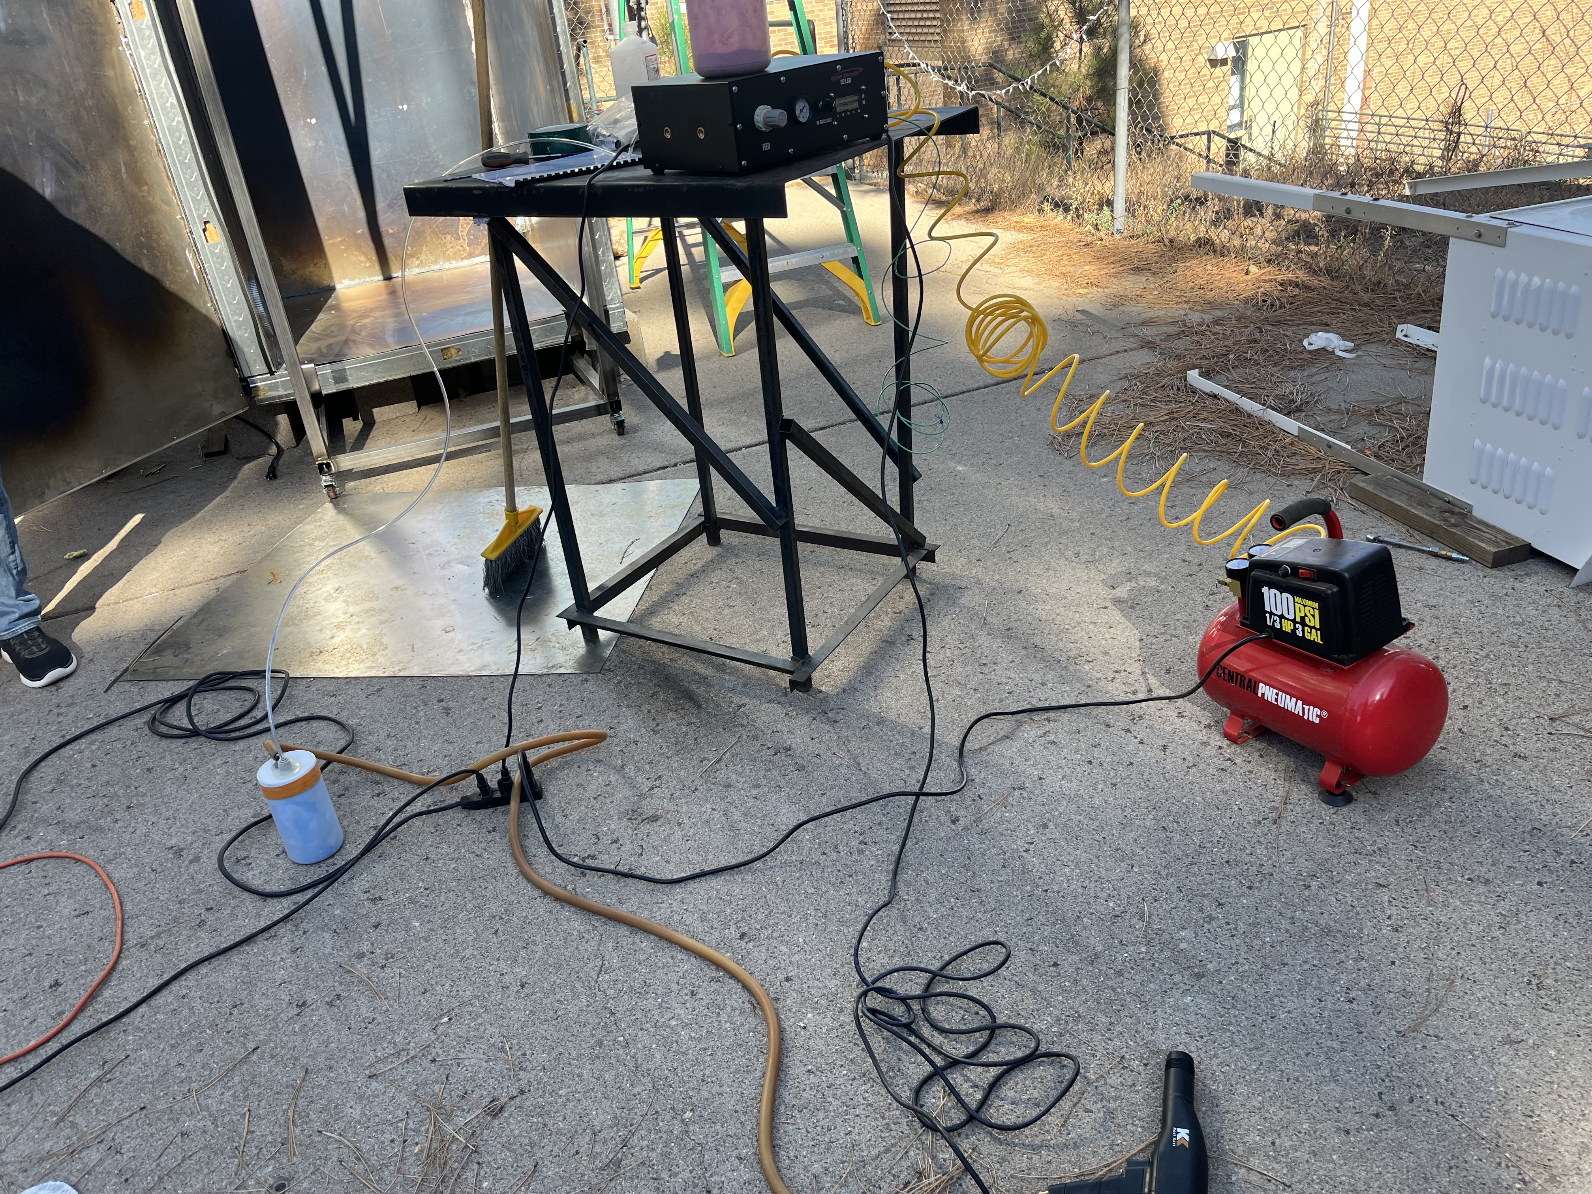
Test 5: Curing technique on rack
Design requirement
  CR2: even heat distribution
  CR5: retractable rack system
Hussain

Slide 11
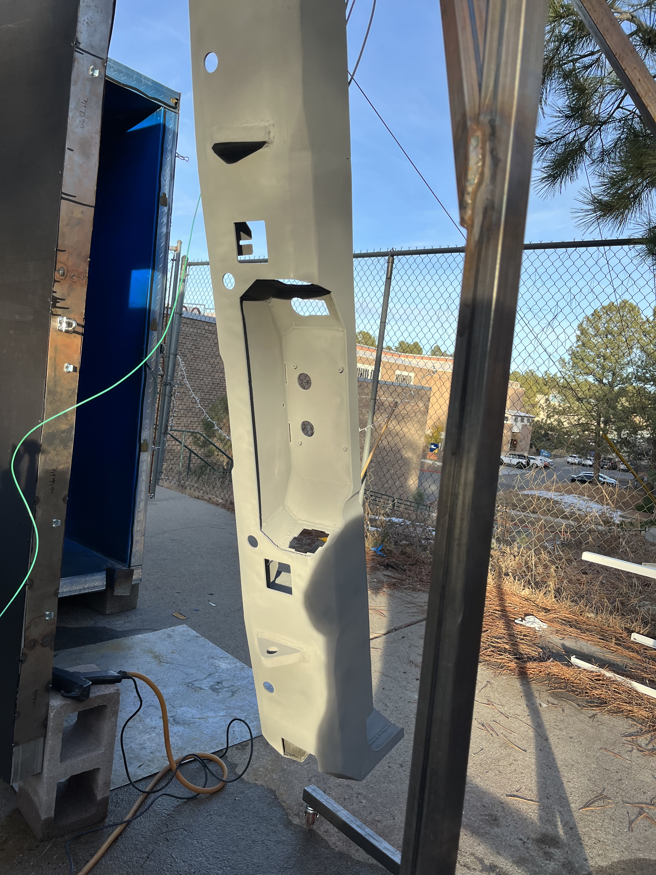
Test 6: Rack system weight Test
Design requirements
  ER1: Rack holding weight < 200 lbs
  CR5: Retractable rack system
Verina

Slide 12
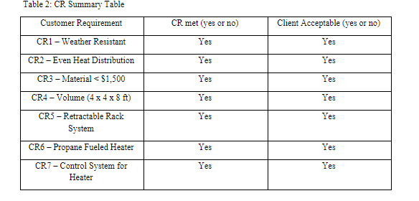
Specifications Sheet: Customer requirements
Verina

Slide 13
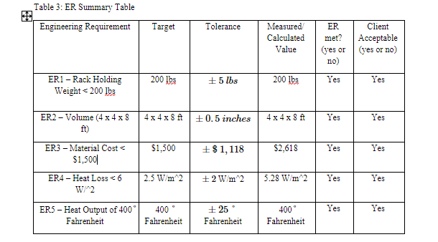
Specifications sheet: engineering requirements
Verina

Slide 14
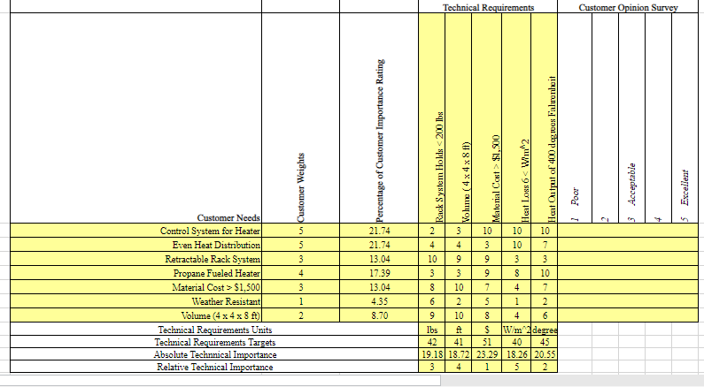
QFD
Verina

Slide 15
Questions?

